Slide 1
MANY WOMEN, MANY FEMINISM, INTERSECTIONALITY

Slide 2
A BRIEF HISTORY OF FEMINISM
WHAT IS FEMINISM
INTERSECTIONALITY
CONCLUSION
05 |
REFERENCE

Slide 3
A BRIEF HISTORY OF FEMINISM
The Suffragette movements of the nineteenth century & early twentieth century constituted 'First wave of Feminism'.
Once the vote had been achieved in the west,the campaign for legal & civil rights assumed lower profile.
Political equality was seen by many feminists to have achieved the principal goal of the feminist movement.

Slide 4
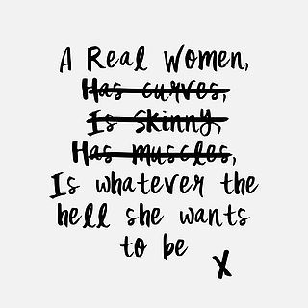
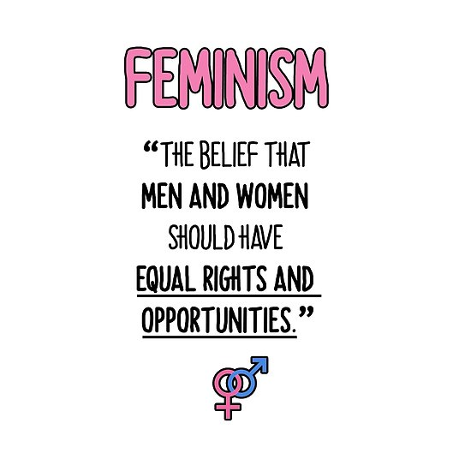
WHAT IS FEMINISM

Slide 5
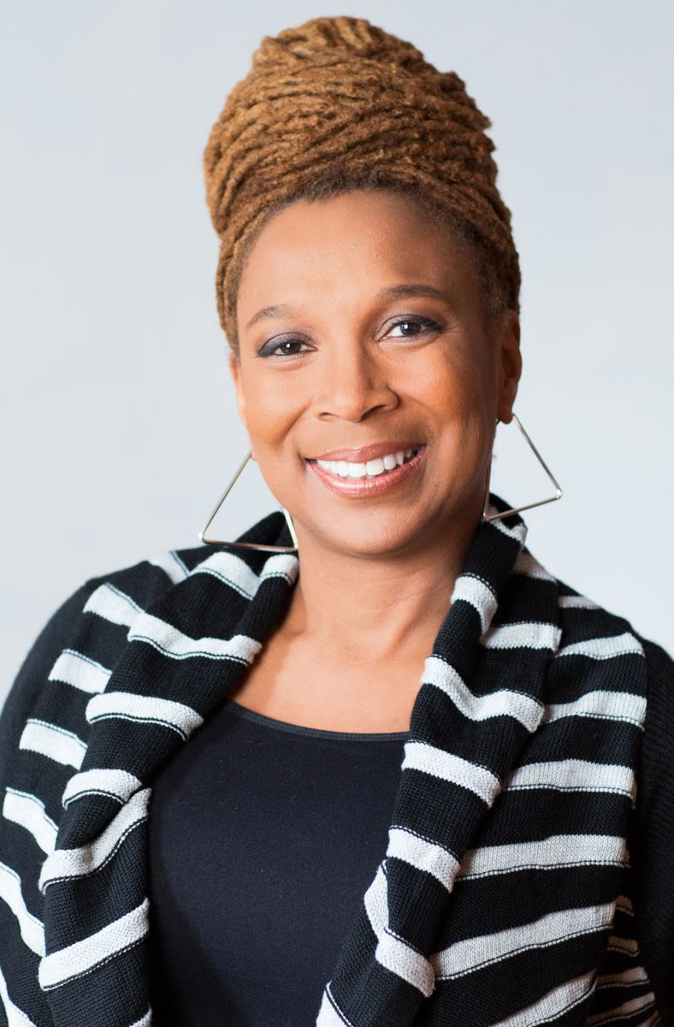
INTERSECTIONALITY
The term was first coined by Black Feminist Scholar Kimberley Williams Crenshaw.
It is also called Intersectional feminism.
It asserts how different aspects of social & political Identity discrimination overlaps I.e. intersects.

Slide 6
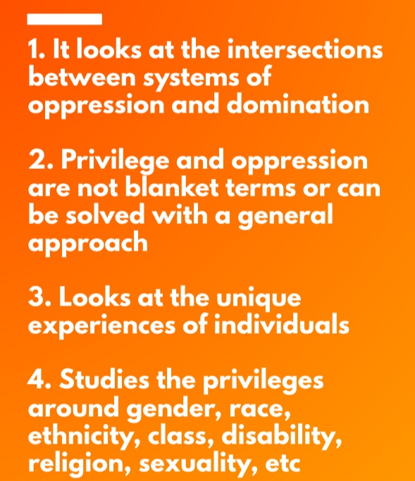
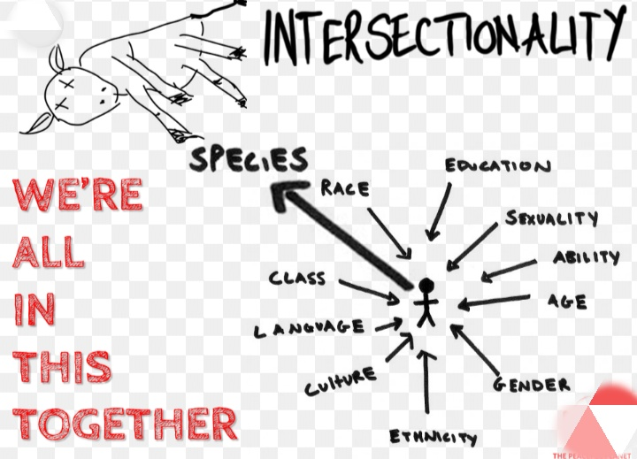

Slide 7
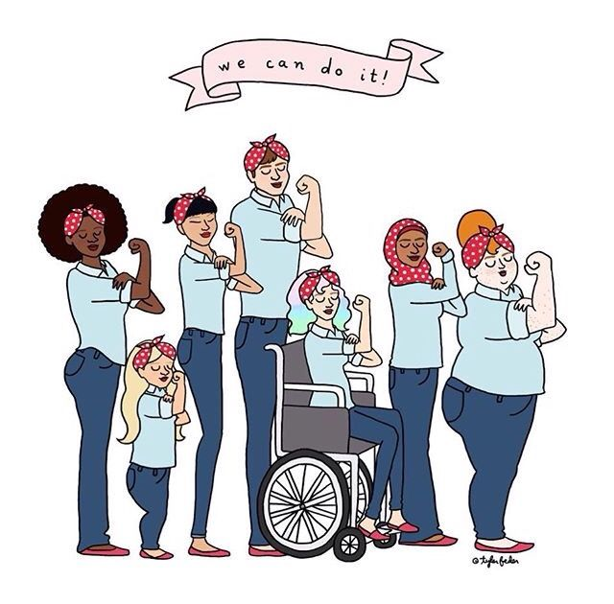
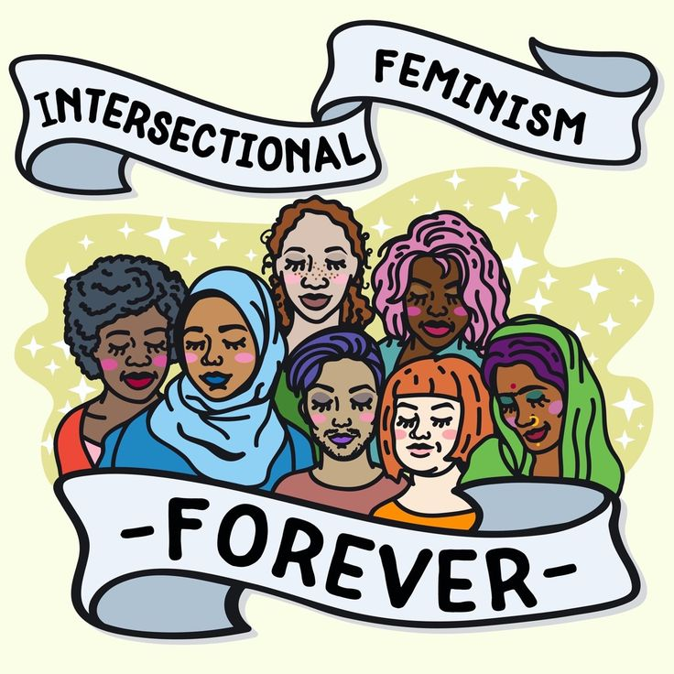

Slide 8
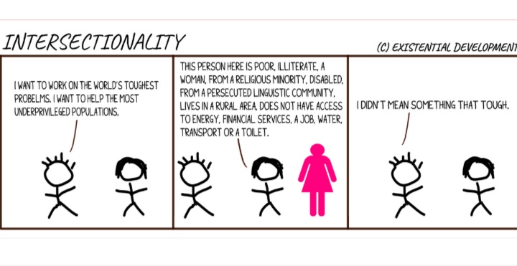

Slide 9
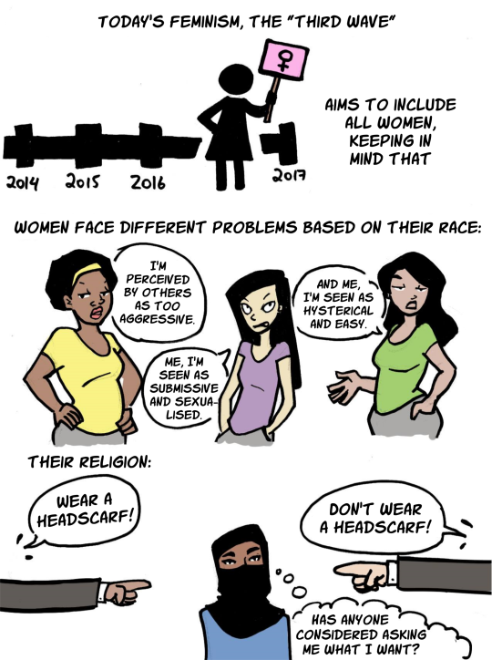

Slide 10
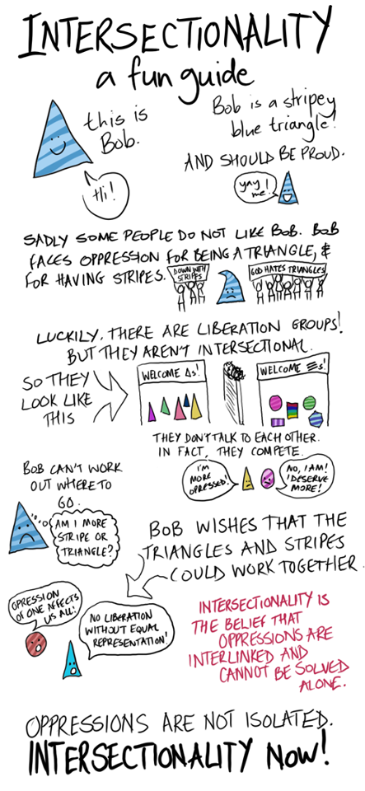

Slide 11
RADICAL FEMINISM
Radical feminism is a movement that believes sexism is so deeply rooted in society that the only cure is to eliminate the concept of gender completely.
It sees man as a enemy & argues that equality requires the elimination of patriarchy.
Care should be taken that Radical feminism should not spread the seeds of new gender conflict.

Slide 12
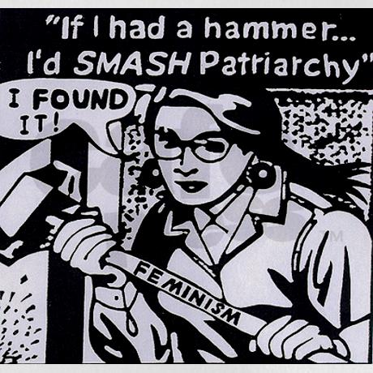

Slide 13
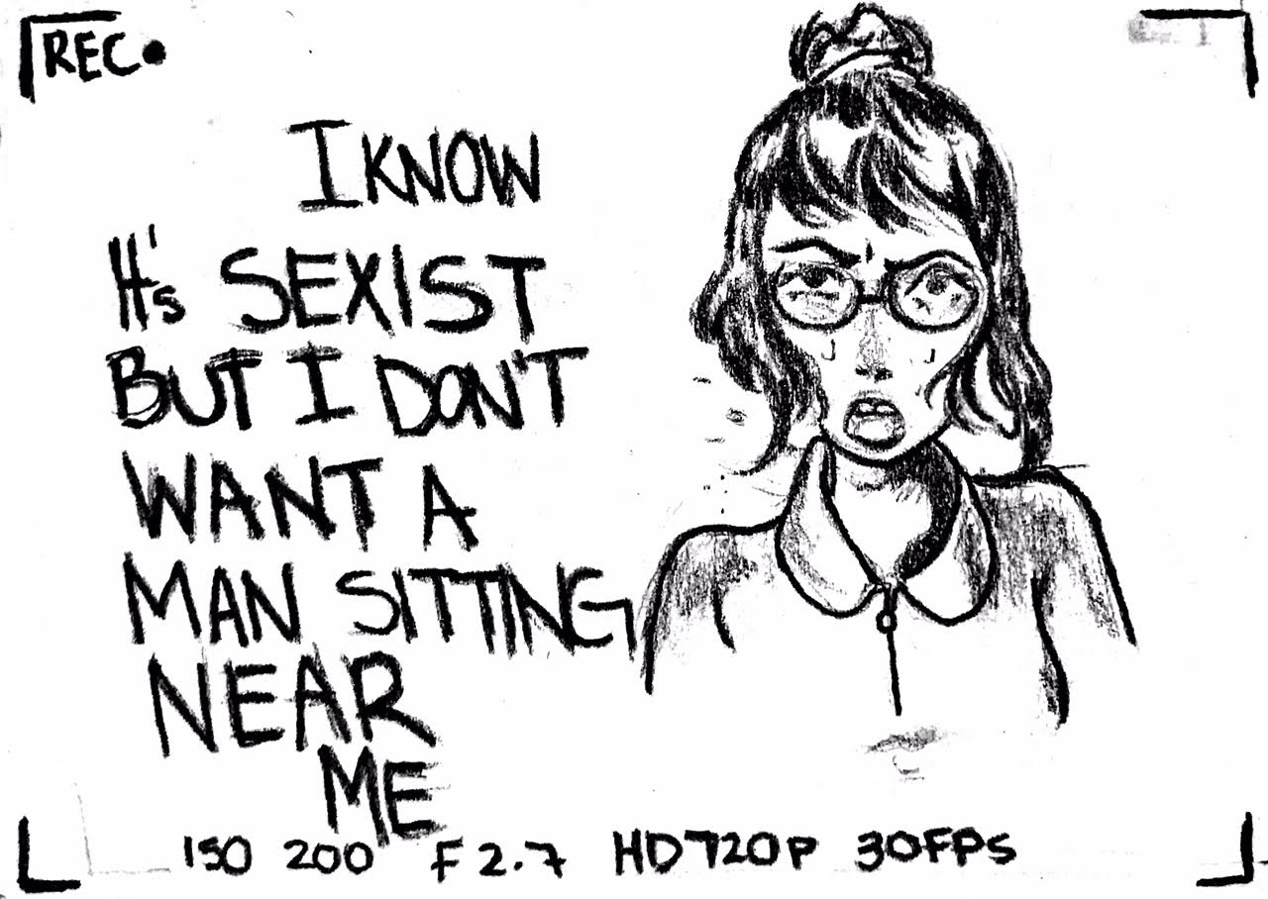

Slide 14
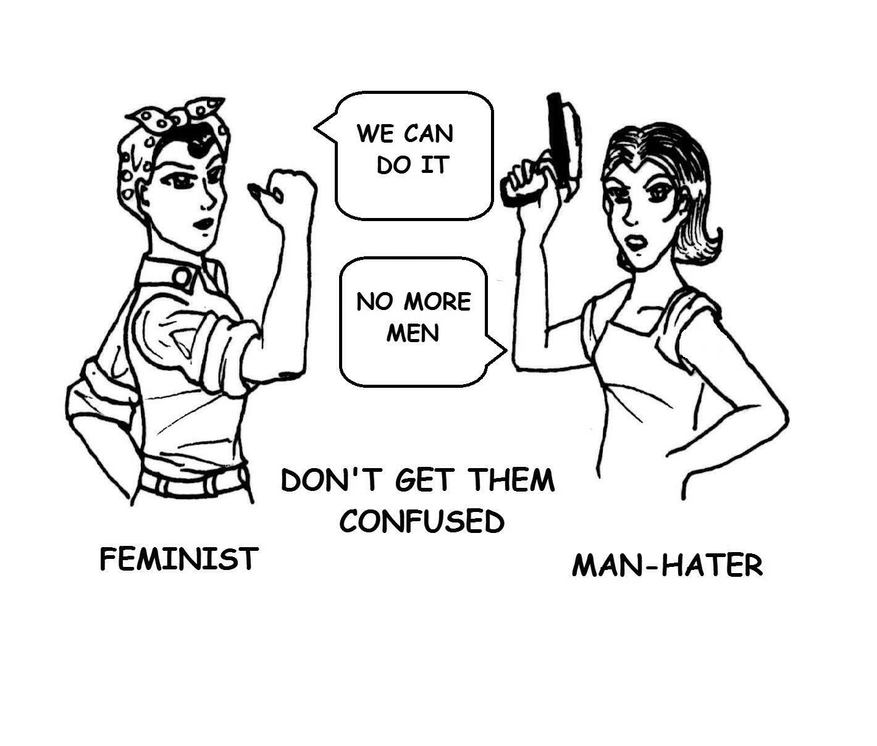

Slide 15
LIBERAL FEMINISM
A movement that believes all individuals should be free to explore every opportunities and rights. It fights for complete gender equality through social, political and legal means.
It argues that society holds the false belief that women are, by nature, less intellectually & physically capable than men.

Slide 16
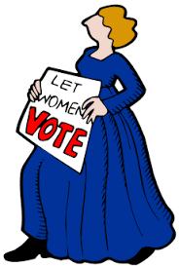

Slide 17
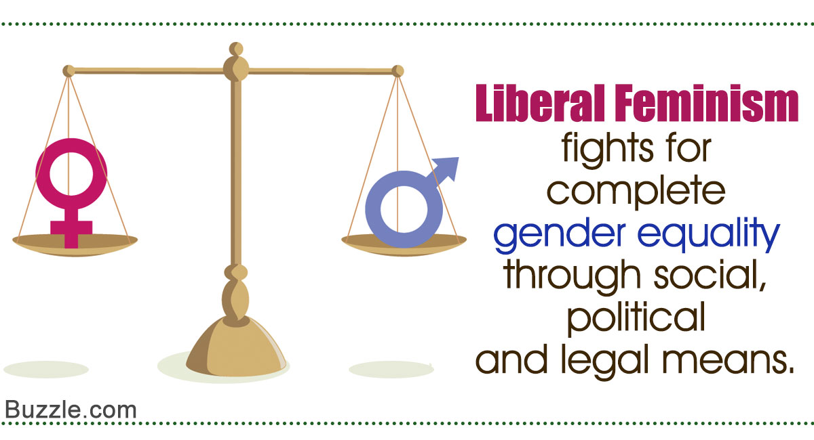

Slide 18
SOCIALIST FEMINISM
It is also called as Marxist feminism. Socialist feminism focuses on economics (capitalism) I.e. differences in wages on the basis of gender & politics.
Radical feminism is the most extreme form, but it is sligjhtly less extreme, but still calls for major social change.
It argues that it is necessary to have a more socialist society, in particular socialized means of child care.
It pursues collective personal liberation.

Slide 20
POSTMODERN FEMINISM
It is the view that "one is not born a woman, but becomes one" & thus here the focus is on the social and cultural construction of women by the society.
Rejects the notion that all women share a single perspective and experience that can be explained by a single grand theory.

Slide 21
CONCLUSION
Incorporation of Intersectionality in every feminist theory is the best way for achieving the rights of /equality for women who are oppressed or discriminated on the grounds of religion, race ,caste, class, gender, nationality, colour ,sexual orientation,etc.

Slide 22
REFERENCES
www.jblearning.com
slideplayer.com
reddit.com
kilipic.pw
visualizepicture.com
nadtaconference.wordpress.com

Slide 23
REFERENCES
www.jblearning.com
slideplayer.com
reddit.com
kilipic.pw
visualizepicture.com
nadtaconference.wordpress.com

