Slide 1
GIS Unit 1

Slide 2
Geographic objects
Not present everywhere in the study area
Objects are usually easily distinguished and named, and their position in space is determined by a combination of one or more of the following parameters:
Location (where is it?)
Shape (what form is it?)
Size (how big is it?)
Orientation (in which direction is it facing?)
How we want to use the information about a geographic object determines which of the four above parameters is required to represent it.

Slide 3
Geographic objects
In-car navigation system → Petrol stations → where they are. Thus, location alone is enough to describe. shape, size and orientation are not necessarily relevant.
Roads →notion of location (where does it begin and end), shape (how many lanes does it have), size (how far can one travel on it) and orientation (in which direction can one travel on it) seem to be relevant information components.

Slide 4
Geographic objects
We usually do not study geographic objects in isolation, but more often we look at collections of objects viewed as a unit
E.g forest plots form forests, groups of parcels form suburbs, roads form a road network
Different objects do not occupy the same location
This natural law of ‘mutual non-overlap’ has been a guiding principle in the design of computer representations of geographic phenomena
We can study graphic phenomena at this more aggregated level and look at characteristics like coverage, connectedness, and capacity

Slide 5
Geographic objects
Which part of the road network is within 5 km of a petrol station?
(A coverage question)
What is the shortest route between two cities via the road network? (A connectedness question)
How many cars can optimally travel from one city to another in an hour?
(A capacity question)

Slide 6
Boundaries
Location, shape and size are fully determined if we know an area’s boundary, so the boundary is a good candidate for representing it.
Crisp and fuzzy boundaries
Crisp boundary → precise, distict zone of change, represented by distinct lines that seperates various regions of the data
Fuzzy boundary →imprecise →an area of transition→ broader region of change
crisp boundaries are more common in man-made phenomena, whereas fuzzy boundaries are more common with natural phenomena

Slide 7
Computer representations of geographic information
In order to represent such a phenomenon faithfully in computer memory, we could either:
Try to store as many (location; elevation) observation pairs as possible, or
Try to find a symbolic representation
Drawbacks:
Infinitely many locations
difficult to derive a function for larger areas
To overcome this we store a finite, but intelligently chosen set of sample and then interpolate it.

Slide 8
Computer representations of geographic information
Interpolation is a method of constructing new data points within the range of a discrete set of known data points. Used to estimate values between two points.
Interpolation is made possible by a principle called spatial autocorrelation. This is a fundamental principle which refers to the fact that locations that are closer together are more likely to have similar values than locations that are far apart - commonly referred to as ‘Tobler’s first law of Geography’.
Spatial autocorrelation is how well data points correlate with other nearby data points across a spatial area.

Slide 9
Tessellations
The process of tessellating the surface
Tessellation of a flat surface is the tiling of a flat surface using one or more geographic shapes called tiles with no overlaps & no gaps.

Slide 10
Regular tessellations
In a regular tessellation, the cells are the same shape and size.
field attribute value assigned to a cell is associated with the entire area occupied by the cell.
The three most common regular tessellation types: square cells, hexagonal cells, and triangular cells.
These tessellations are known under various names in different GIS packages, but most frequently as rasters.

Slide 11
Irregular tessellations
more adaptive to geographic phenomena
region quadtree
It is based on a regular tessellation of square cells, but takes advantage of cases where neighbouring cells have the same field value, so that they can together be represented as one bigger cell.
It shows a Quadtrees
small 8 8 raster with three possible field values: white, green and blue. The
quadtree that represents this raster is constructed by repeatedly splitting up the
area into four quadrants, which are called NW, NE, SE, SW
The procedure produces an upside-down, tree-like structure, known as a
quadtree.

Slide 12
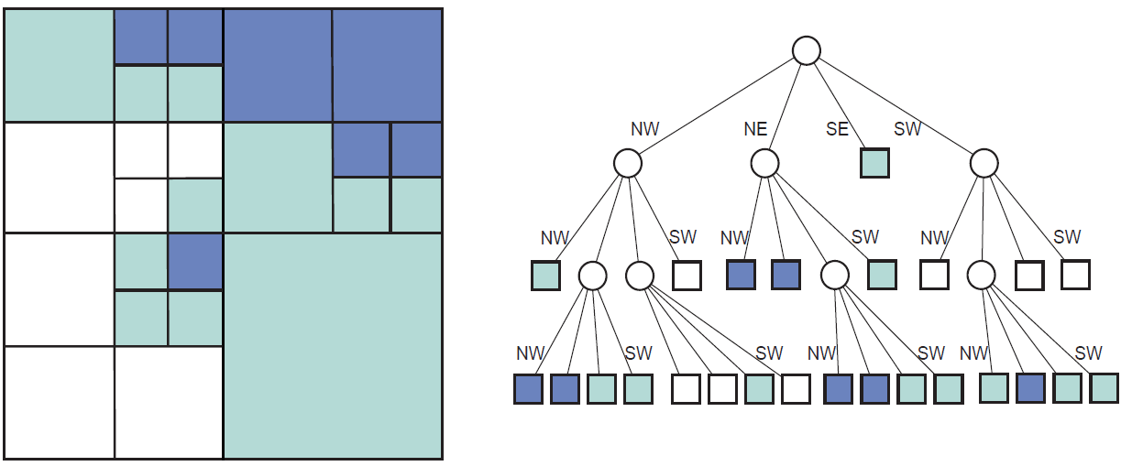

Slide 13
