Slide 1
AUGUST COMTE (1798-1857)
LIFE AND TIMES OF AUGUST COMET (BIOGRAPHY)
LAWS OF THREE STAGES
POSITIVISM

Slide 2
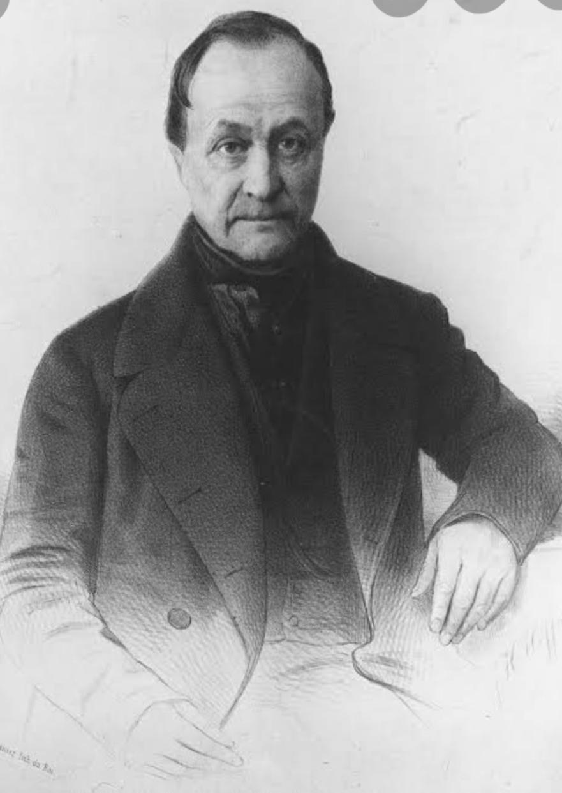
* LIFE AND TIMES OF AUGUST COMTE:
August Comte was the first social thinker who gave the name 'sociology' to a science of human behaviour.
Comte was born in Montpellier, Herault on ' 19 January 1798’.

Slide 3
After attending the Lycee Joffre and the university of Montpellier, Comte was admitted to Ecole Politechnique in Paris .
The Ecole closed in 1916 for reorganization, however, and Comte continued his studies at the medical School at Montpellier.

Slide 4
After 1822 he became a student and secretary to Henride Saint- Simon, who brought Comte into contact with intellectual society.
During that time Comte Published his first eassay in the various publications. Headed by Saint- Simon, L' Industries , Le politique , and L'organisateur ( Charles Dunoyer and Charles Comte's Conseur European), although he would not published under his own name until 1819’s.
In 1824, Comte left Saint.

Slide 5
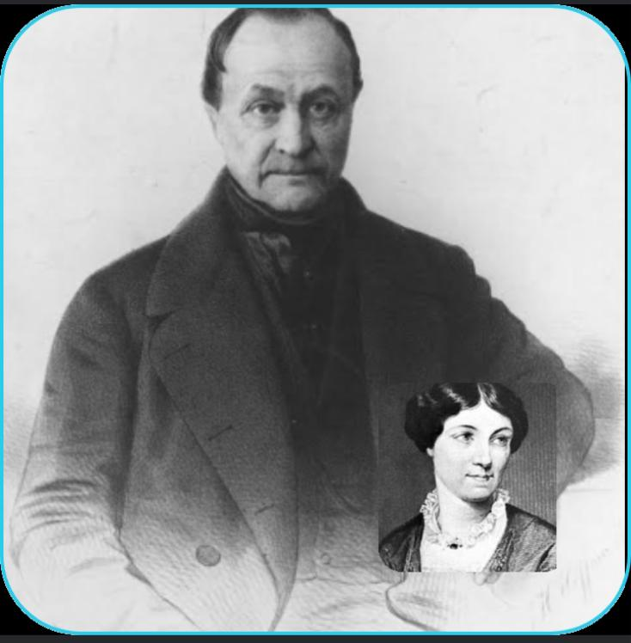
August Comte married
Comte married ‘Caroline Masson' in 1825.
In 1826 he was taken to mental hospital, but left without being cured. He would later attempt Suicide in 1827 by jumping off the pont des Art . In 1842, he published the six volume of his cours.

Slide 6
* Books Published by August Comte
He published four volumer of system de politique positive (1851-1854).
His final work, the first volume of La Synthese subjective (“ the subjective synthesis”), was published in 1856.
Comte died in Paris on 5 September 1857 from stomach cancer.
His apartment from 1841-1857 is now conserved as the Maison d’ August Comte and is located at 10 rue Monsieur-le-Prince, in Paris 6th arrondissement.

Slide 7
*LAWS OF THREE STAGES OR THEORY OF HUMAN PROGRESS
STAGES | TIME PERIOD | RULED DOMINATED | PREDOMINATED SOCIAL UNIT
THEOLOGICAL | Early Humankind | Priests and military | The Family
METAPHYSICAL | Middle ages to beginning of Renaissance | Churches and Lawyers | The states
SCIENTIFIC | Industrialization | Industry Leaders, science moral guidelines | The entire human race

Slide 8
* THEOLOGICAL STAGE HAVE THREE TYPES
FETISHISM: Belief in some living spirit Spirit is the non Living objects.
POLYTHEISM: Belief in several God’s as well as Natural and Human forces.
MONOTHEISM: Belief one God who is Supreme .

Slide 9
* POSITIVISM
A philosophical ideology and movement , positivism first assumed its distinctive features in the work of Comte, who also named and systematized the science of sociology.
It then developed through several stages known by various names, such as empiriocriticism, logical positivism, and logical empiricism, finally merging, in the mid-20th century, into the already existing tradition known as analytic philosophy.

Slide 11
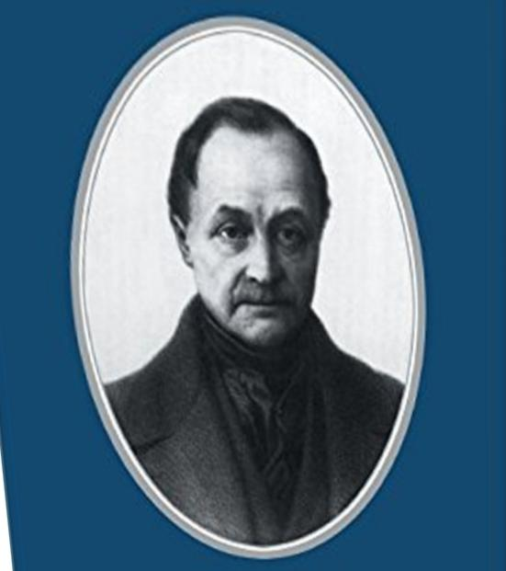
The basic affirmations of positivism are .
(1) that all knowledge regarding matters of fact is based on the “positive” data of experience and ,
(2) that beyond the realm of fact is that of pure logic and pure mathematics.
Comte’s Positivism was posited on the assertion a so called law of the Three chases(or stages)of intellectual development.
There is a parallel,as Comte saw it,between the evolution of thought patterns in the entire history of humankind, on the one hand , and in the history of individuals development.

Slide 12
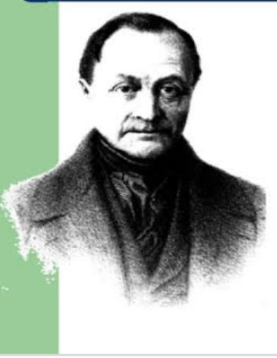
In the first, or so called Theological stage natural phenomena are explained as the results of supernatural or divine powers. It matters not whether the religion is polytheistic or monotheistic;. In either case miraculous powers or will are believed to produced the observed event.
The second phase, called metaphysical, is in some cases marely a depersonalized theology: the observable process of nature are assumed to arise from impersonal power occurred qualities vital forces or entelechies .
In other instances, the realm of observable facts is considered as an imperfect copy or imitation of external ideas, aa in Plato’s metaphysics of pure forms .

Slide 13
Thoughts by Auguste Comte

